Slide 1







Home-Owned Robotic Arm:
Senior Design II
Fall Semester, 2024
Group 10
Emanuel Alvarez :
Electrical Engineer
Hani Bdeir :
Computer Engineer
Hailey Gorak :
Computer Engineer
Jackson Jacques III :
Electrical Engineer
Nkunu Nuglozeh :
Electrical Engineer
Mentor/Coordinator: Dr. Chung Yong Chan

Slide 2
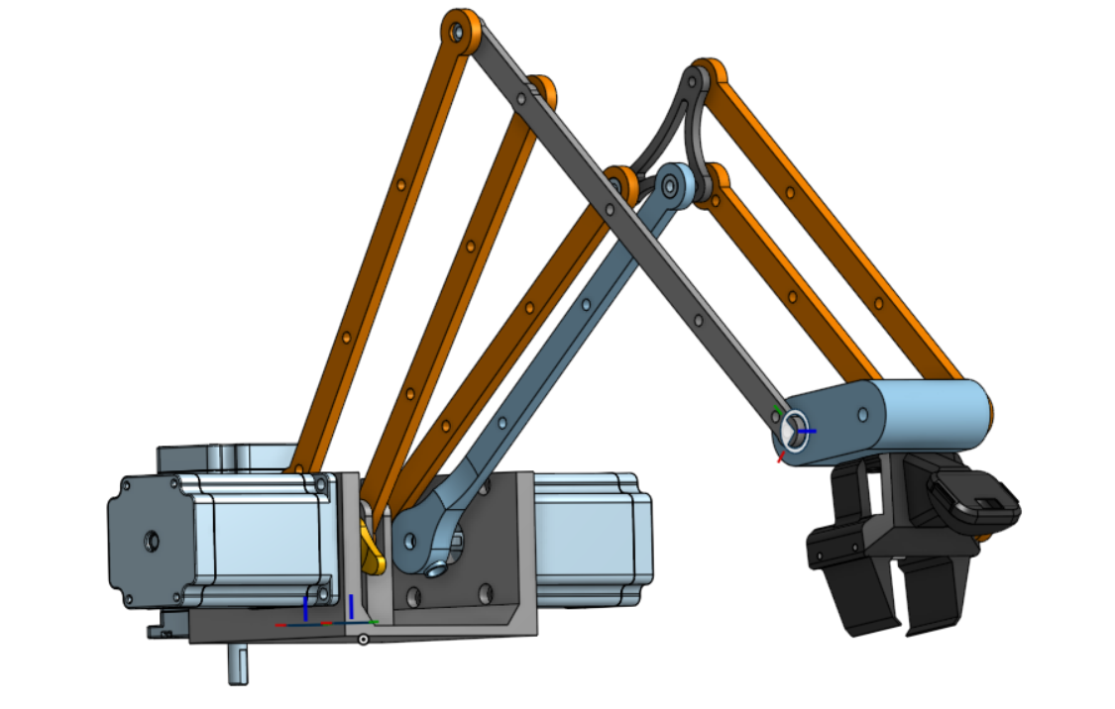
What is it?
A home-sized robotic arm akin to factory-floor robotics, designed to include safety features for its operators.
Designed to be operated via remote control and simulator, allowing operator to move all joints, as well as an end effector.
Simulator provides feedback to the system, allowing for course-correction.

Slide 3
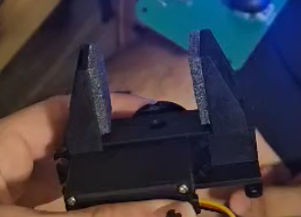
What is it?
A home-sized robotic arm akin to factory-floor robotics, designed to include safety features for its operators.
Designed to be operated via remote control and simulator, allowing operator to move all joints, as well as an end effector.
Simulator provides feedback to the system, allowing for course-correction.

Slide 4
Systems/Subsystems
Gripper End-Effector to grasp objects.
Versatile, replaceable with practically any end effector.

Slide 5
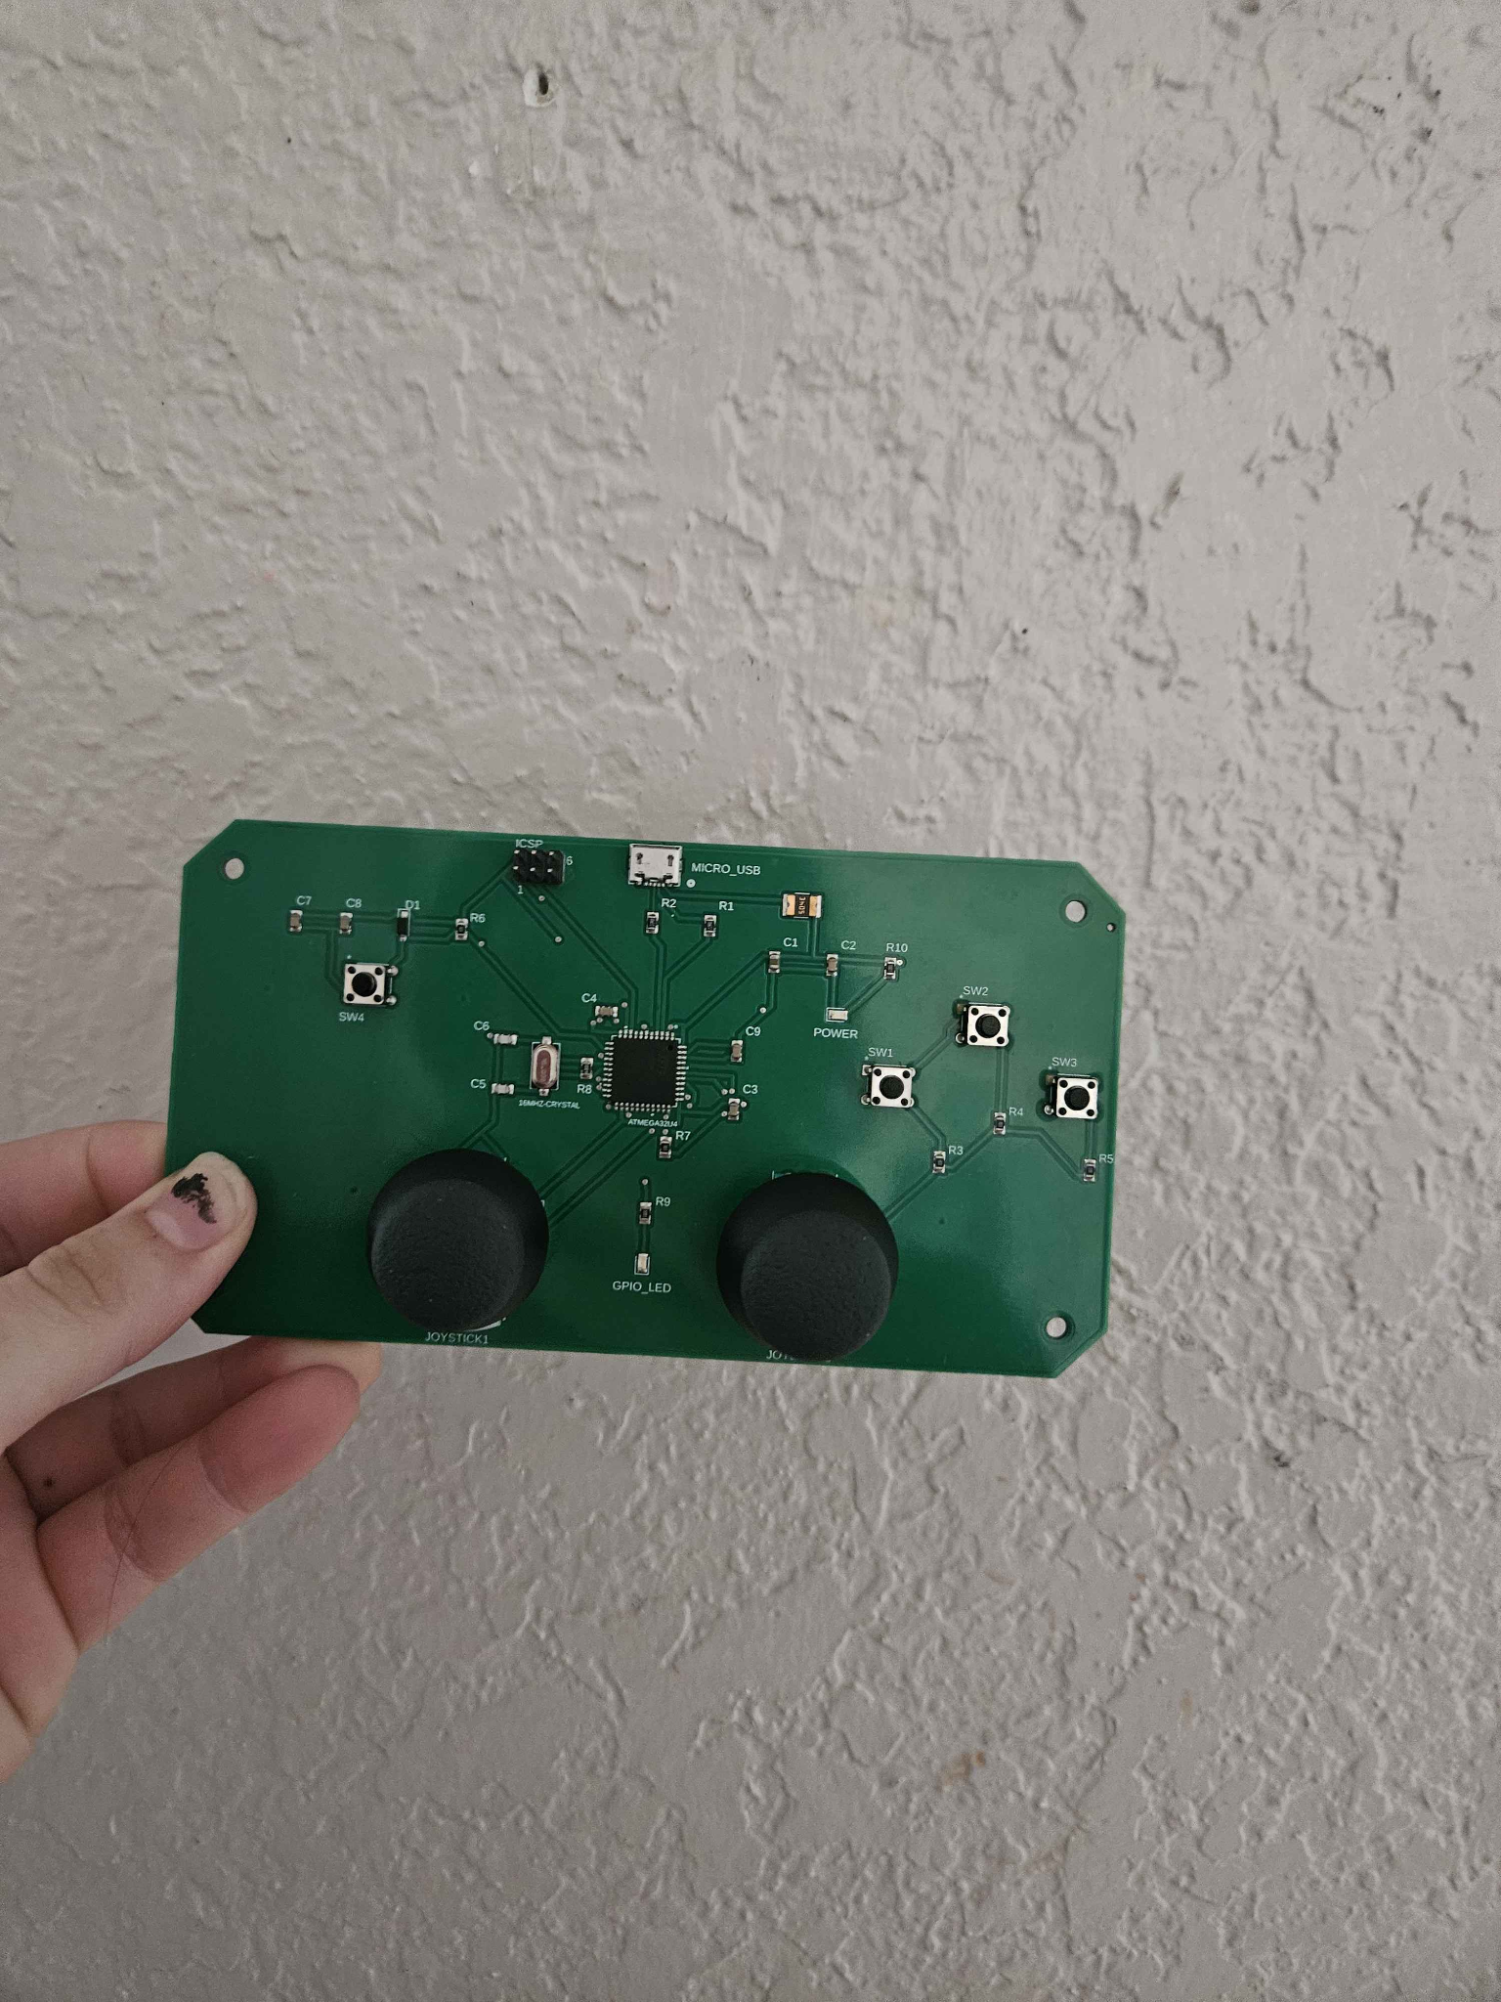
Systems/Subsystems
Reset Button
Joystick for Joint Control
Record/Replay
Emergency Stop
End Effector

Slide 6
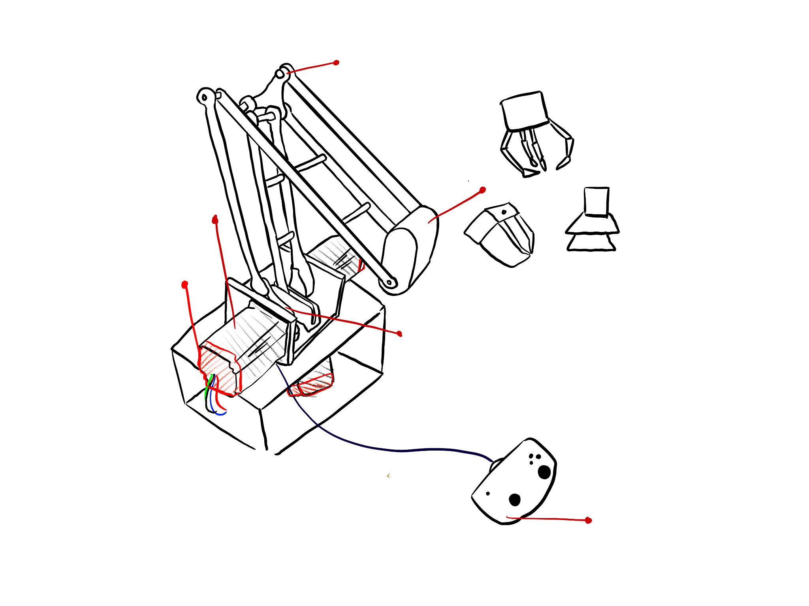
Systems/Subsystems
Joint Axis
Motor 1 moves arm up and down
End Effector Attachment
Motor
Encoder
Joint Axis
Housing for power, regulators, CAN, peripherals, and computer
Motor 2 moves base, allowing arm to spin
Joystick

Slide 7
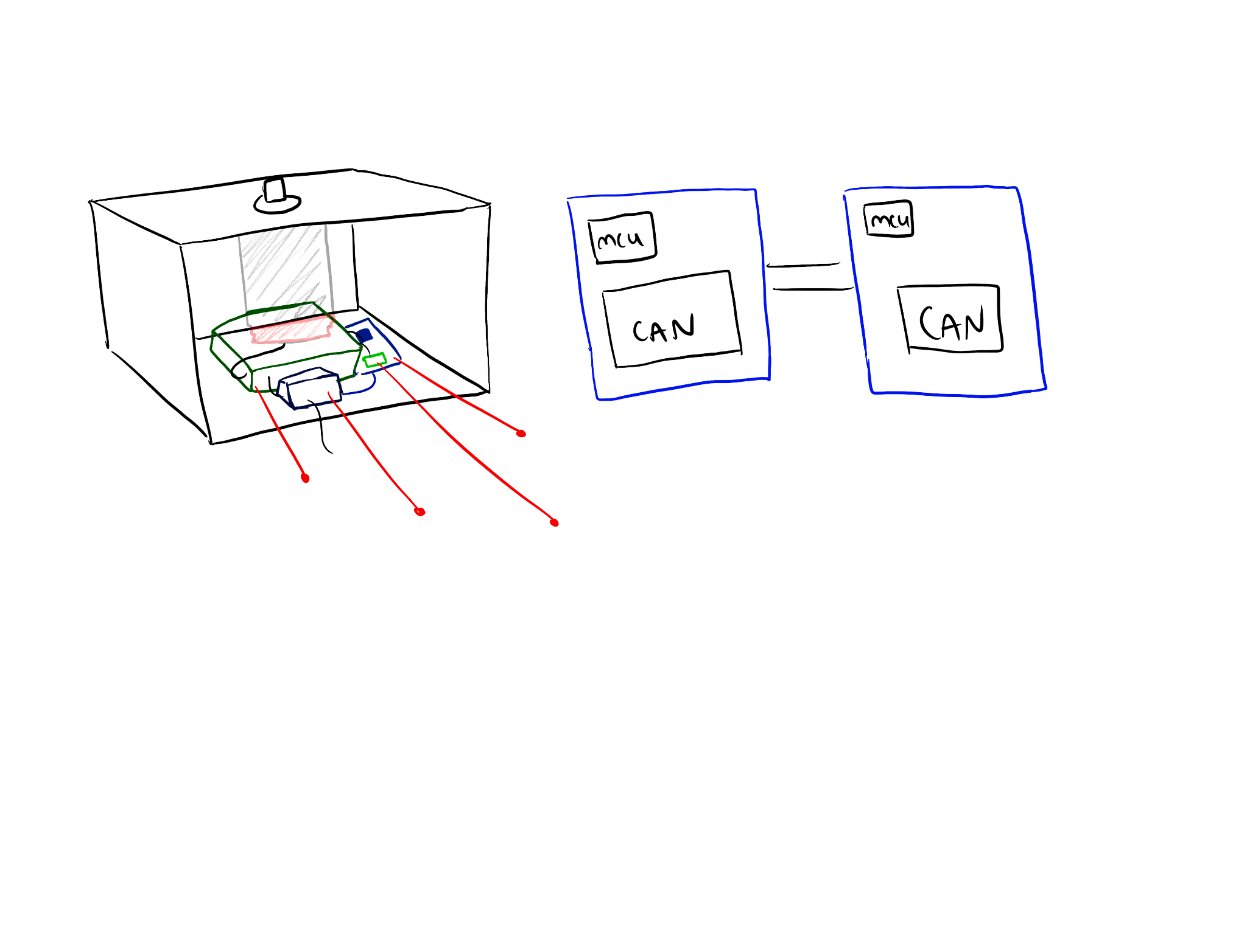
Systems/Subsystems
Housing
MCUs, CAN
24V Source
Regulator, Motor Controller, Encoders, Sensors
Computer

Slide 8
Testing
Use functioning systems to showcase some key engineering specifications
Most important systems are the motors and being able to drive them accurately
Power is also a huge issue. Without enough power the motors won’t have the proper torque
The joysticks are crucial to being able to manipulate the robotic arm and must work with very little delay

Slide 9
Thank you!
We hope you enjoyed the demonstration!

Slide 10
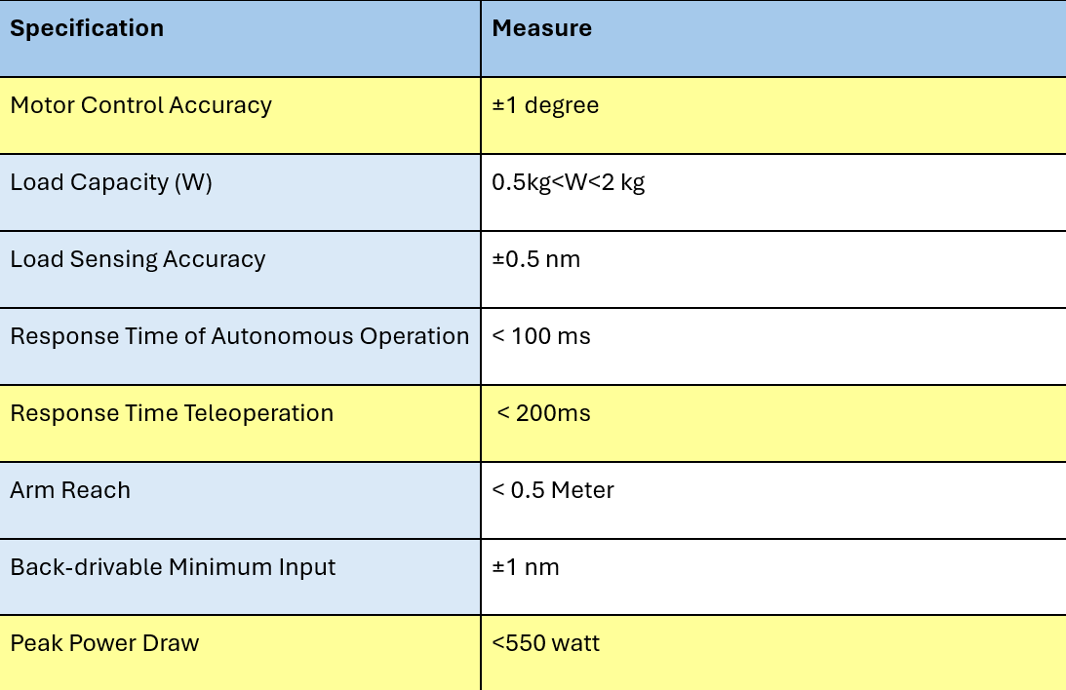
Key Engineering Specifications

Slide 11
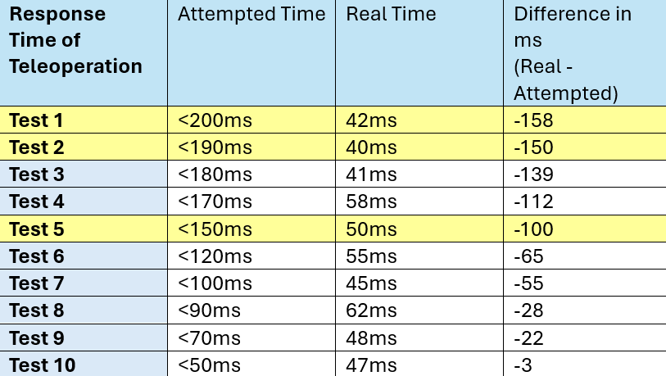
Response Time of Teleoperation

Slide 12
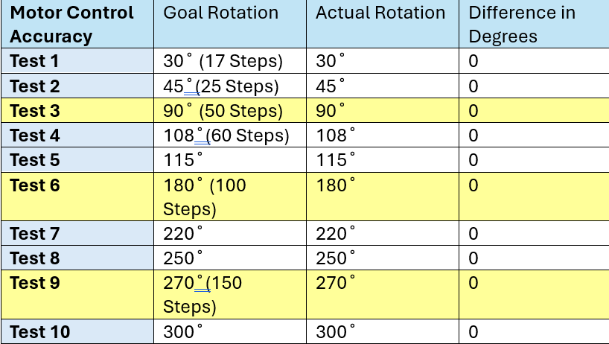
Motor Control Accuracy

Slide 13
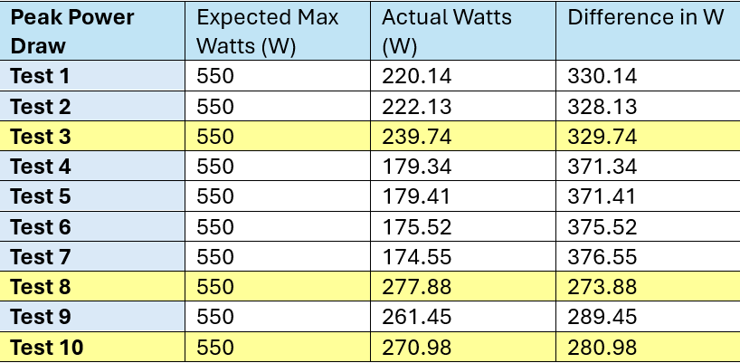
Peak Power Draw

